Slide 1
Concurrent Programming I
HPPS
David Marchant
Based on slides by:
Troels Henriksen, Randal E. Bryant and David R. O’Hallaron

Slide 2
Concurrent Programming
So far we’ve talked about threads and processes each running a complete programme
Each programme has been sequential in nature
We can spread processing over several threads or processes, each part of the same programme
Twice the resources means twice the speed! (Nope)

Slide 3
The Basic Idea
We can break our processing over several workers
Many hands make light work
Single process
Runs for 10 mins
Two processes
Each run for 5 mins

Slide 4
Logical View of Threads
Threads associated with process form a pool of peers
Each thread can be processed in parallel
Threads associated with process foo
T2
T4
T1
shared code, data
and kernel context
T5
T3

Slide 5
Concurrent Threads
Two threads are concurrent if their flows overlap in time
Otherwise, they are sequential
Examples:
  Concurrent: A & B, A&C
  Sequential: B & C
Thread A
Thread B
Thread C
Time

Slide 6
Concurrent and Parallel Threads
Single Core Processor
  Simulate parallelism by time slicing
Multi-Core Processor
  Can have true parallelism
Thread A
Thread B
Thread C
Thread A
Thread B
Thread C
Time
Run 3 threads on 2 cores

Slide 7
Parallel Systems are the default
For many years now mulit-core systems have been standard
If we paid for 8 cores, we want to use them!
...and not just on running background processes with slightly fewer context switches, we want a single programme to use the all of the hardware

Slide 8
Parallelism is about speed.
How do we quantify whether parallelisation made a program faster, and by how much?
How can we estimate the potential benefit of parallelising a program?
Are there limits to the potential gains of parallelism?So far we’ve talked about threads and processes each running a complete programme

Slide 9
Latency
Often called runtime
How long it takes for a program to run on some workload.
Both difficult and easy to measure
Wall time is the time it takes in the real world.
CPU time is the total amount of time spent executing code counting all processors.
Two processes
Each run for 5 mins
Single process
Runs for 10 mins
Here the CPU time is the same,
But the wall time has halved

Slide 10
Latency
Suppose we have two programmes, P1 and P2 that each perform the same task, and take T1 and T2 respectively:
Speedup greater than one means P2 is faster than P1 , else it is slower.
P1 and P2 must solve the same problem for their latencies to be comparable.
HINT: This is a good metric to include in any reportorting on your own programmes
T1
Latency=
T2

Slide 11
Throughput
Sometimes latency is inappropriate—what is the running time of a potentially-infinite web server?
Can measure latency for individual requests, but is that really useful?
E.g. web requests served per second, or number of bytes processed per clock cycle.
Using throughput we can compare programs that have different workloads.
Workload
Throughput=
Time

Slide 12
Speedup in Throughput
Suppose we have two programmes, P1 and P2 that each perform the same task, and have a throughput of Q1 and Q2 respectively:
Speedup greater than one means P2 is faster than P1 , else it is slower.
P1 and P2 must solve the same problem for their throughputs to be comparable.
HINT: This is another good metric to include in any reportorting on your own programmes
Q1
Throughput Speedup =
Q2

Slide 13
Scalability
Basically how well our system improves (or not) as we make it bigger
Both are similar, but we are altering different parameters in our system
How the system improves in its capacity (runtime or throughput) as we add more resources, such as more processors
How the system throughput changes as we add more workload

Slide 14

Scalability Example
Rendering Mandelbrot fractals
Each pixel can be computed
independently
The image size corresponds to
the workload
Regarding parallelism, there are
two sorts of scalability that we are
interested in.

Slide 15
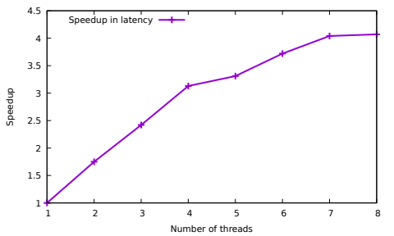
Strong Scaling
How the runtime varies with the number of processors for a fixed problem size.
This shows sub-linear strong scalability—8 threads barely gets us 4 × speedup
Speedup graph for rendering a 10⁴ pixel Mandelbrot fractal as we use more threads:

Slide 16
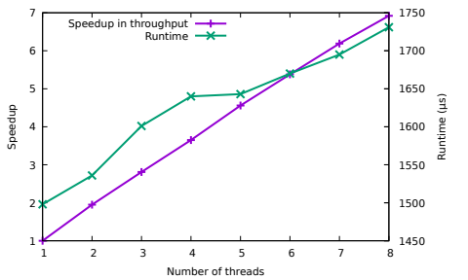
Weak Scaling
How the runtime varies with the number of processors for a fixed problem size relative to the number of processors.
Pretty decent weak scalability! By far more common than strong scalability.
Speedup graph for rendering a Mandelbrot fractal with 10⁴ pixels per thread:

Slide 17
How do we estimate the potential benefits of parallelising a program, without just implementing it and measuring how well it goes?

Slide 18
Amdahl’s Law
If p is the proportion of execution time that benefits from parallelisation, then S(N) is maximum theoretical speedup achievable by execution on N processors, and is given by:
Why can p not equal 1?
Reading, writing and other fundamentally sequential parts mean p will never be 1 in practice
1
S(N) =
p
(1-p) +
N

Slide 19
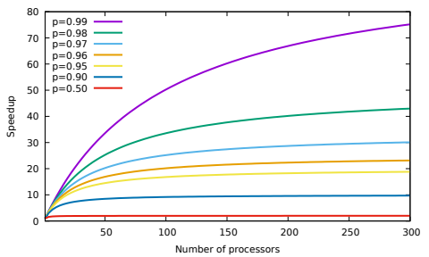
Amdahl’s Law

Slide 20
Amdahl’s Law
Amdahl’s Law predicts strong scalability.
For a fixed problem size, there will always come a point of diminishing returns.
Makes parallelisation seem pointless…
You have a simulation that runs in 1 hour.
Then you get a computer that is ten times faster.
Usually you don’t decide to run the simulation in six minutes, instead you make a simulation that is ten times as precise and still runs in 1 hour.
Consider weather forecasting...
Bigger machines let us solve bigger problems in the same time!
But...

Slide 21
Gustafson’s Law
If s is the proportion of execution time that must be sequential, then S(N) is maximum theoretical speedup achievable by execution on N processors, and is given by:
Assumes that parallel workload increases just as fast as number of processors.
Predicts weak scalability.
In practice often more relevant than Amdahl’s Law.
S(N) = N + (1-N) x s

Slide 22
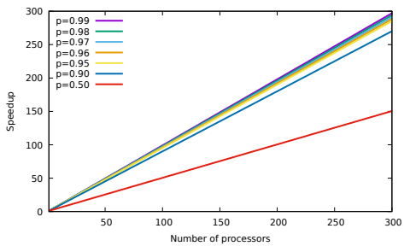
Gustafson’s Law

Slide 23
The Fine Print
Both Amdahl’s and Gustafson’s Laws are idealised abstractions and ignore important real-world concerns:
    Locality.
    Communication.
    Synchronisation.
But they are still a good theoretical framework for estimating the value of parallelising some program.
Neither should be used to calculate timings or parallelisation in an implemented system.

Slide 24
How do we start throwing threads at our problems?

Slide 25
Parallel Loops
For scientific computing, we are mostly concerned with parallelising straightforward loops such as this matrix multiplcation code
Iterations of the outer two loops are independent.
Can be computed by different threads.
void matmul(int n , const double ∗x ,
const double ∗y , double ∗out ) {
for ( int i = 0 ; i < n ; i++) {
for ( int j = 0 ; j < n ; j++) {
out [ i ∗n+j ] = 0 ;
for ( int l = 0 ; l < n ; l++) {
out [ i ∗n+j ] += x [ i ∗n+j ] ∗ y [ i ∗n+j ] ;
}
}
}
}

Slide 26
Simplest OpenMP Example
Directives used to indicate how run C program in parallel.
Clauses (covered later) can be used to customise the behaviour.
Semantics are the sequential elision—how the program would behave if we ignored the directives.
We are only scratching the surface of OpenMP in this course!
#pragma omp parallel for
for (int i = 0 ; i < n ; i++) {
A[i] = A[i] * 2;
}

Slide 27
Simplest OpenMP Example
print (“Program Starts\n”);
n = 1000;
#pragma omp parallel for
for (int i=0; i<n; i++) {
A[i] = B[i] + C[i];
}
m = 500;
#pragma omp parallel for
for (int j=0; j<m; j++) {
p[j] = q[j] - r[j];
}
print (“Program Ends\n”);
exit(0),
Sequential
Parallel
Sequential
Parallel
Sequential
Program starts sequential.
Parallel regions split across multiple threads.
Parallel region ends when all threads done.
Worker threads kept running in background.

Slide 28
Compilation
#include <stdio.h>
#include <stdlib.h>
int main (void) {
int n = 100000000;
int ∗arr = malloc (n∗sizeof(int)) ;
#pragma omp parallel for
for (int i=0; i<n; i++) {
arr[ i ] = i ;
}
free(arr);
}
$ gcc -o openmp-example openmp-example.c -fopenmp

Slide 29
Controlling the number of threads
$ time OMP_NUM_THREADS=1 ./openmp-example
real 0m0.124s
user 0m0.034s
sys 0m0.090s
$ time OMP_NUM_THREADS=2 ./openmp-example
real 0m0.076s
user 0m0.033s
sys 0m0.104s
$ time OMP_NUM_THREADS=3 ./openmp-example
real 0m0.054s
user 0m0.039s
sys 0m0.133s
$ time OMP_NUM_THREADS=4 ./openmp-example
real 0m0.046s
user 0m0.054s
sys 0m0.184s
Wall time
CPU time (user)
CPU time (system)
Wall time
CPU time (user)
CPU time (system)
Wall time
CPU time (user)
CPU time (system)
Wall time
CPU time (user)
CPU time (system)

Slide 30
Memory model
Variables declared inside a loop iteration are private.
Variables declared outside are shared.
Be extremely careful when modifying shared variables—OpenMP will not protect you!
This is known as a race condition, multiple threads are reading and writing to the same location. Who gets there first? We don’t know!
We will cover this in more depth next week
Main
Double sum=0;
#pragma omp parallel for
for (int i = 0 ; i < n ; i++) {
sum += A[i];
}
sum
0
Thread 1
Thread 2
sum
0
sum
0
sum
1
sum
1
sum
?

Slide 31
Reductions
Instead of doing a summation sequentially
we can do it like:
and have one compute the left part, and a second one compute the right, combining their results at the end.
(((((((x0 + x1) + x2) + x3) + x4) + x5) + x6) + x7)
(x0 + x1 + x2 + x3) + (x4 + x5 + x6 + x7)
Is this valid?

Slide 32
Reductions
Instead of doing a summation sequentially
we can do it like:
and have one compute the left part, and a second one compute the right, combining their results at the end.
(((((((x0 ⊕ x1) ⊕ x2) ⊕ x3) ⊕ x4) ⊕ x5) ⊕ x6) ⊕ x7)
(x0 ⊕ x1 ⊕ x2 ⊕ x3) ⊕ (x4 ⊕ x5 ⊕ x6 ⊕ x7)
What about now?

Slide 33
Reductions
A binary operator ⊕ : α → α → α is said to be commutative if
It is associative if
We can do a parallel “sum” with any associative operator, called a reduction.
For convenience, we also tend to require a neutral element 0⊕:
x ⊕ y = y ⊕ x
x ⊕ (y ⊕ z) = (x ⊕ y) ⊕ z
x ⊕ 0⊕ = 0⊕ ⊕ x = x

Slide 34
Reduction example
double dotprod (int n, double ∗x, double ∗y) {
double sum = 0 ;
#pragma omp parallel for reduction (+: sum)
for (int i=0; i<n; i++) {
sum += x[i] ∗ y[i] ;
}
return sum ;
}
Must initialise accumulator variable to neutral element.
Must explicitly tell OpenMP the combining operator (+, ∗, −, &&, || , &, |, ^, max, or min).

Slide 35
Parallelising Matrix Multiplication
void matmul_seq(int n , const double ∗x ,
const double ∗y, double ∗out) {
for (int i=0; i<n; i++) {
for (int j=0; j<n; j++) {
double acc = 0;
for (int l=0; l<n; l++) {
acc += x[i∗n+l] ∗ y[j∗n+l] ;
}
out[i∗n+j] = acc;
}
}
}
Runtime for n=1000: 2.69s.
Three nested loops.
Which do we parallelise, and how?

Slide 36
Parallelising Matrix Multiplication
void matmul_seq(int n , const double ∗x ,
const double ∗y, double ∗out) {
#pragma omp parallel for
for (int i=0; i<n; i++) {
for (int j=0; j<n; j++) {
double acc = 0;
for (int l=0; l<n; l++) {
acc += x[i∗n+l] ∗ y[j∗n+l] ;
}
out[i∗n+j] = acc;
}
}
}
Runtime: 0.80s (was. 2.69s seq) — pretty good for adding one line of code!
But this only parallelises across the rows of the result matrix.

Slide 37
Parallelising Matrix Multiplication
void matmul_seq(int n , const double ∗x ,
const double ∗y, double ∗out) {
#pragma omp parallel for collapse(2)
for (int i=0; i<n; i++) {
for (int j=0; j<n; j++) {
double acc = 0;
for (int l=0; l<n; l++) {
acc += x[i∗n+l] ∗ y[j∗n+l] ;
}
out[i∗n+j] = acc;
}
}
}
collapse(2) clause combines loops to one parallel n*n iteration loop,
Runtime: 0.93s (was 0.80s without collapse) — not much impact here.
Would matter more if we had fewer iterations in outer loop.

Slide 38
Parallelising Matrix Multiplication
void matmul_seq(int n , const double ∗x ,
const double ∗y, double ∗out) {
for (int i=0; i<n; i++) {
for (int j=0; j<n; j++) {
double acc = 0;
#pragma omp parallel for reduction(+:acc)
for (int l=0; l<n; l++) {
acc += x[i∗n+l] ∗ y[j∗n+l] ;
}
out[i∗n+j] = acc;
}
}
}
Runtime: 2.48s (vs. 2.69s sequential)—this sucks.
Almost always better to parallelise outermost loops.

Slide 39
Parallelising Matrix Multiplication
void matmul_seq(int n , const double ∗x ,
const double ∗y, double ∗out) {
#pragma omp parallel for
for (int j=0; j<n; j++) {
for (int i=0; i<n; i++) {
double acc = 0;
for (int l=0; l<n; l++) {
acc += x[i∗n+l] ∗ y[j∗n+l] ;
}
out[i∗n+j] = acc;
}
}
}
Runtime: 0.80s (was. 0.80 first ordering)
No real effect here as both loop are the same, but can exploit locality for some small but easy speedup

Slide 40
Scheduling Clauses
By default, OpenMP splits the iterations of a parallel loop evenly among the threads (static scheduling). This is not always optimal.
int fib (int n) {
if (n <= 1) {
return 1;
} else {
return fib(n−1) + fib(n−2);
}
}
Consider a loop that computes fib(i) for each i<n.
Since time to compute fib(i) is over twice that of fib(i-1), the threads with the early iterations finish much faster than the threads with the later iterations.
#pragma omp parallel for schedule(static)
for (int i=0; i<n; i++) {
fibs[i] = fib(i);
}

Slide 41
Dynamic Scheduling
Dynamic scheduling assigns each thread an iteration, and is given more iterations when it finishes.
No idle threads (as long as there are unclaimed iterations to run).
#pragma omp parallel for schedule(dynamic)
for (int i=0; i<n; i++) {
fibs[i] = fib(i);
}
On my machine static ran in 5.2s, where dynamic ran in 2.27s—much better!
By default, assigns single iterations at a time, which is slow for very large loops with quick iterations.
Use schedule(dynamic,K) to schedule K iterations at a time to threads.

Slide 42
Summary
Parallelism is about speedup.
Describe performance differences with speedup.
  Latency for programs that compute the same thing.
  Throughput if not.
Strong scaling is solving the same problem faster.
Weak scaling is solving a bigger problem in the same time.
OpenMP is a simple language extension for parallelising loops in C programs.
Use #pragma omp parallel for to parallelise a for-loop.
Generally parallelising the outer most loop works best

